Slide 1

Blockchain based Web Framework for Pharma supply chain
Group No. 17
Satish Gupta(18104024)
Yash Bhosale(18104049)
Jainam chopra(18104064)
Project guide: Apeksha Mohite
Co-Guide : Nahidkausar Shaikh

Slide 2
Contents
Introduction
Objectives
Problem Definition
Technological Stack
Review Suggestions (Given in Last meeting)
Proposed System Architecture/Working
Prototype Design Demonstration
Implementation Status
Status of Paper Draft & Targeted Conference

Slide 3
Introduction
Problem Identified:
  Product tracking and tracing is impossible in current supply chain infrastructure.
  Risk of Counterfeit products also increases as there is no monitoring.
  Due to no in-depth visibility in real time, cant catch the hold of parties liable for damage.
Solution Proposed:
  Blockchain platform using IOTEX & HYPER LEDGER FABRIC.
  IOT Single board mounted sensors used to accumulate important data.
  Migrating the data to blockchain product using cloud technology.
  Providing a user interface in form of a web based Dapp for all the parties in the supply chain.

Slide 4
Objectives
To make the process transparent and free from human errors, which traditionally were present in the existing infrastructure.
To get a near real time update of the whereabouts of a shipment.
To create trust between new parties due to the use of immutable transactions present in the blockchain, which proves the trustworthiness.
To build a simple user interface for a common customer to use it.

Slide 5
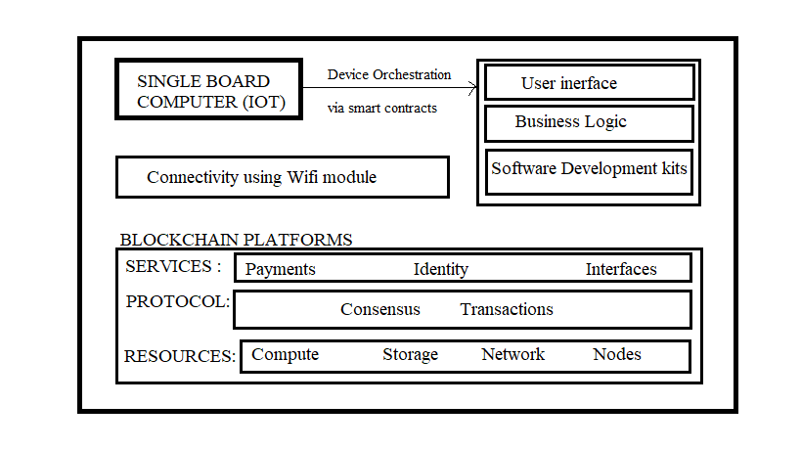
Proposed System Architecture

Slide 6
Technological Stack
Backend – Hyperledger fabric, NodeJS , IOTEX , IBM BLOCKCHAIN
Frontend - React.js, CSS, JavaScript, SAP
Database - IPFS Storage
Server Side Frameworks - Express.js, node.js
IOT FRAMEWORK: Aurdino Ide, Node red, Tinker-cad, Think Speak

Slide 7
Review Suggestions
To change the technology from Ethereum to Hyperledger fabric.
To finalize the End user interface Web app/ Mobile App.
Wether to use a Cloud platform.

Slide 8
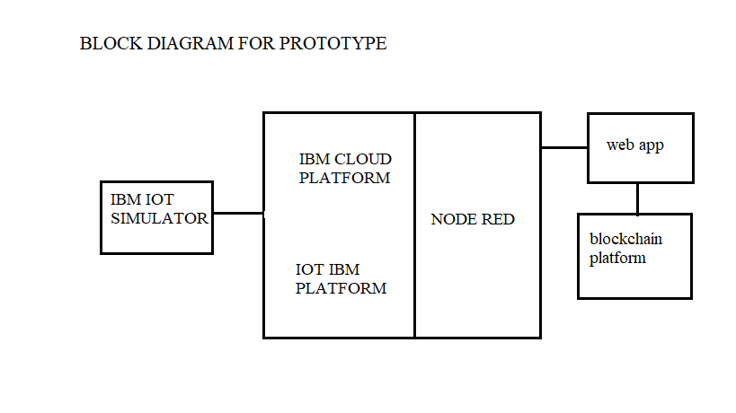
Prototype design Demonstration

Slide 9

Implementation Status

Slide 10
Status of Paper Draft & Targeted Conference
AICTC 2021 3rd International Conference on Advances in Information Communication Technology & Computing

Slide 11
Thank You...!!

